Slide 1
Section 10.4
Vectors
Copyright © 2012 Pearson Education, Inc. Publishing as Prentice Hall.

Slide 2

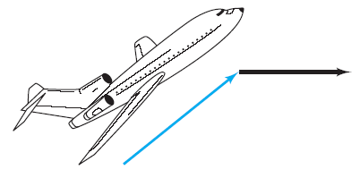
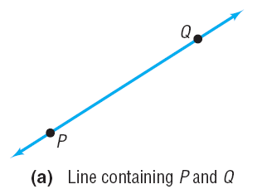
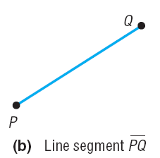
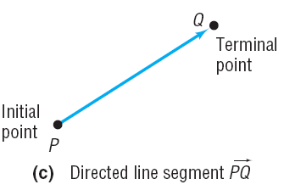
Copyright © 2012 Pearson Education, Inc. Publishing as Prentice Hall.

Slide 3
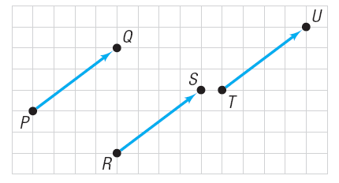

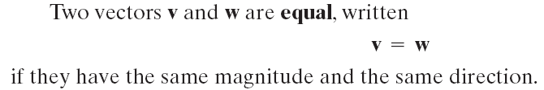
Copyright © 2012 Pearson Education, Inc. Publishing as Prentice Hall.

Slide 4

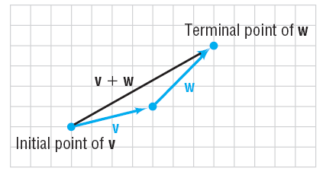
Copyright © 2012 Pearson Education, Inc. Publishing as Prentice Hall.

Slide 5
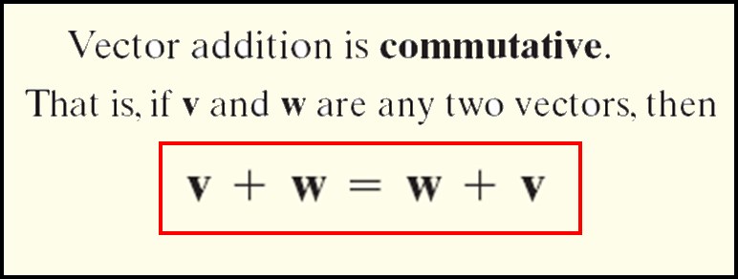
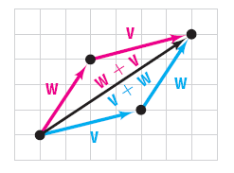
Copyright © 2012 Pearson Education, Inc. Publishing as Prentice Hall.

Slide 6
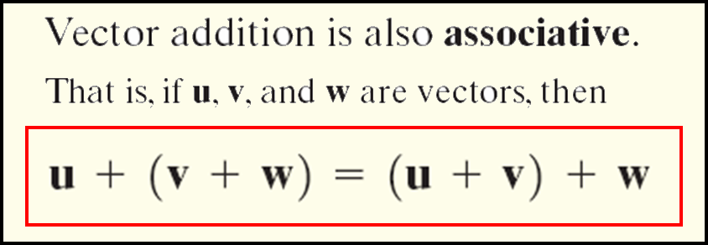
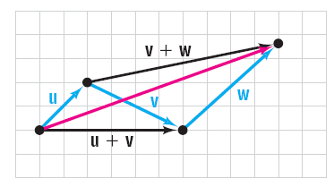

Copyright © 2012 Pearson Education, Inc. Publishing as Prentice Hall.

Slide 7

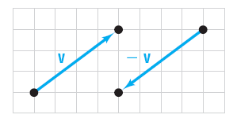

Copyright © 2012 Pearson Education, Inc. Publishing as Prentice Hall.

Slide 8
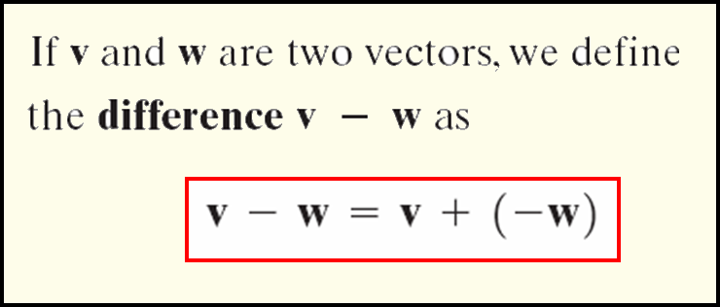
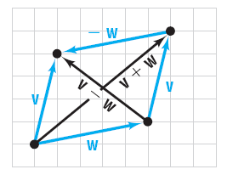
Copyright © 2012 Pearson Education, Inc. Publishing as Prentice Hall.

Slide 9

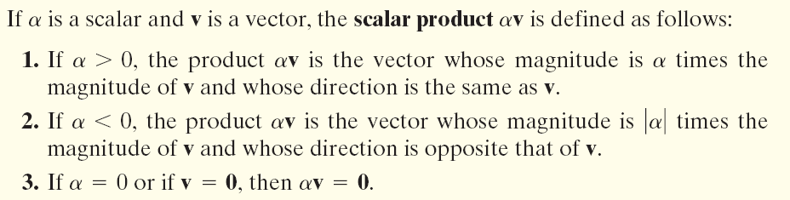
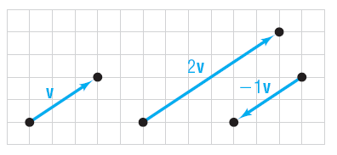
Copyright © 2012 Pearson Education, Inc. Publishing as Prentice Hall.

Slide 10
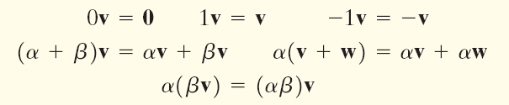
Copyright © 2012 Pearson Education, Inc. Publishing as Prentice Hall.

Slide 11

Copyright © 2012 Pearson Education, Inc. Publishing as Prentice Hall.

Slide 12


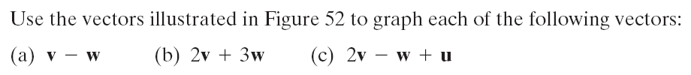
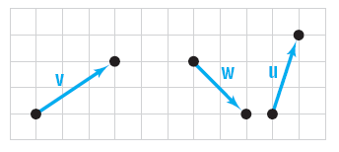
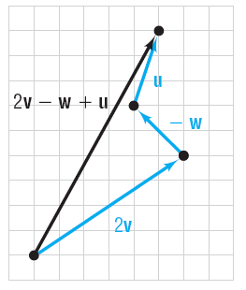
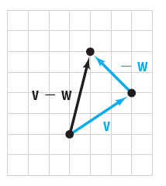
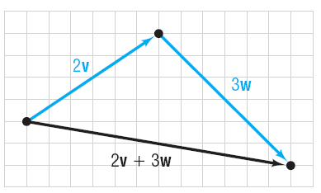
Copyright © 2012 Pearson Education, Inc. Publishing as Prentice Hall.

Slide 13

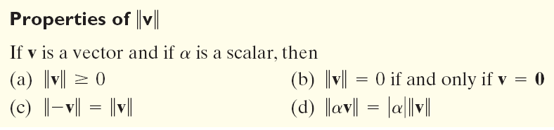
Copyright © 2012 Pearson Education, Inc. Publishing as Prentice Hall.

Slide 14

Copyright © 2012 Pearson Education, Inc. Publishing as Prentice Hall.

Slide 15
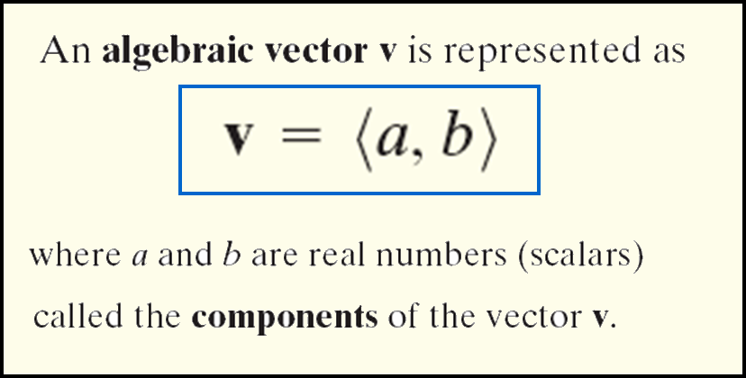
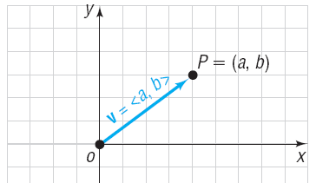
Copyright © 2012 Pearson Education, Inc. Publishing as Prentice Hall.

Slide 16

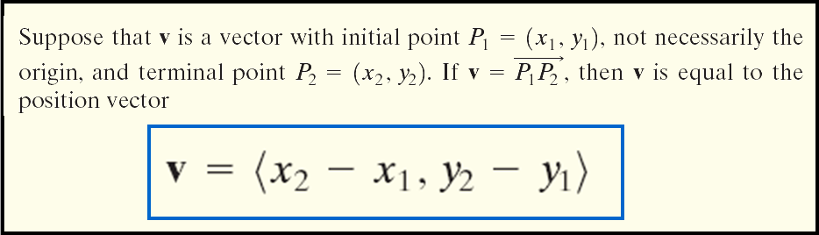
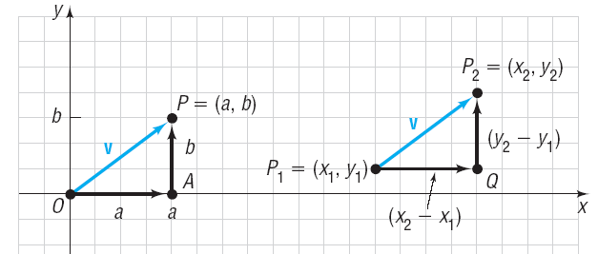
Copyright © 2012 Pearson Education, Inc. Publishing as Prentice Hall.

Slide 17
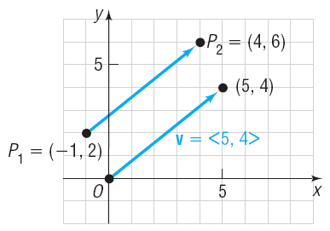
Copyright © 2012 Pearson Education, Inc. Publishing as Prentice Hall.

Slide 18

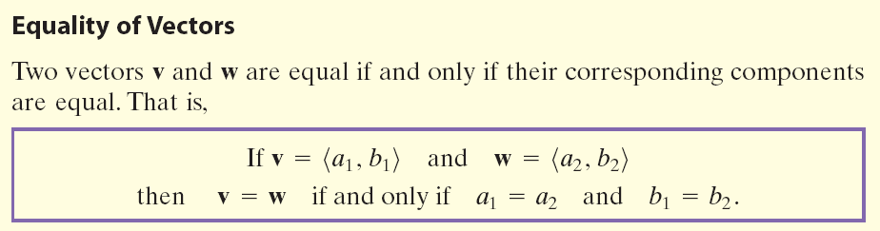
Copyright © 2012 Pearson Education, Inc. Publishing as Prentice Hall.

Slide 19
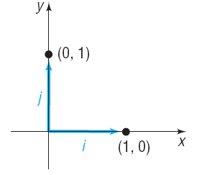

Copyright © 2012 Pearson Education, Inc. Publishing as Prentice Hall.

Slide 20
Copyright © 2012 Pearson Education, Inc. Publishing as Prentice Hall.

Slide 21
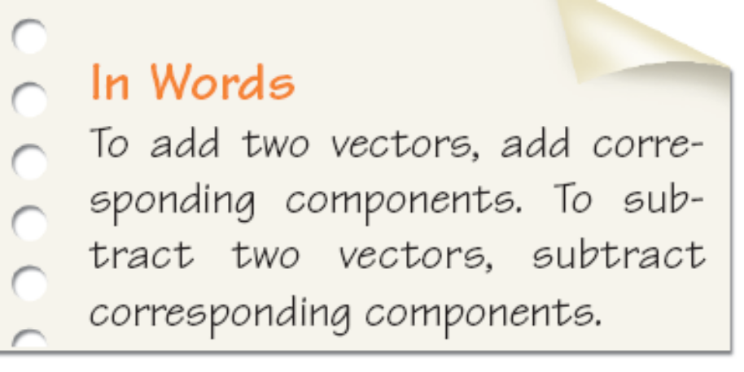
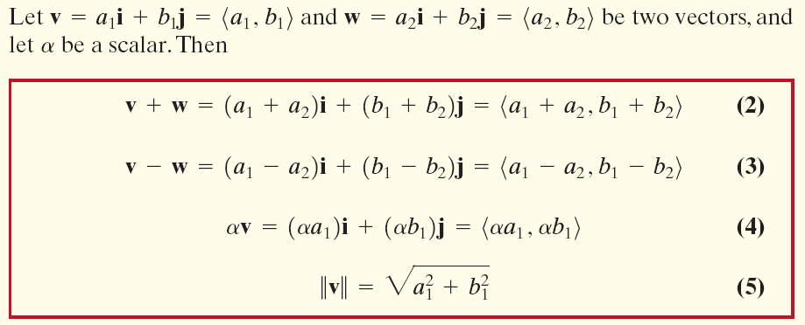
Copyright © 2012 Pearson Education, Inc. Publishing as Prentice Hall.

Slide 22
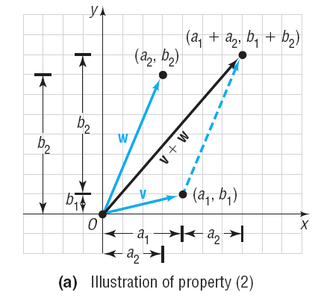
Copyright © 2012 Pearson Education, Inc. Publishing as Prentice Hall.

Slide 23

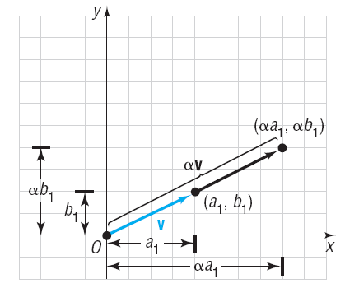
Copyright © 2012 Pearson Education, Inc. Publishing as Prentice Hall.

Slide 24

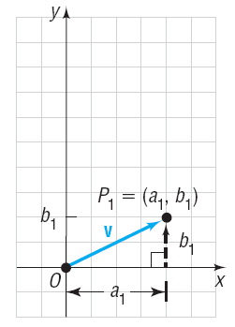

Copyright © 2012 Pearson Education, Inc. Publishing as Prentice Hall.

Slide 25

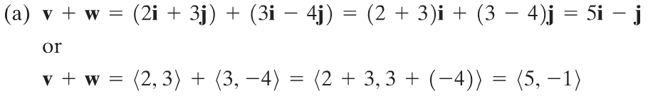
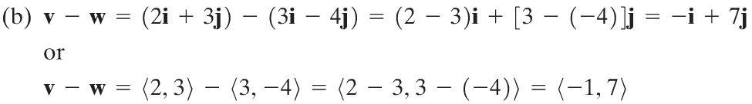
Copyright © 2012 Pearson Education, Inc. Publishing as Prentice Hall.

Slide 26
Copyright © 2012 Pearson Education, Inc. Publishing as Prentice Hall.

Slide 27
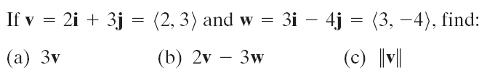
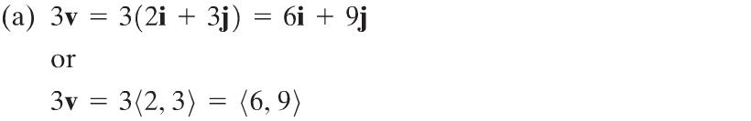
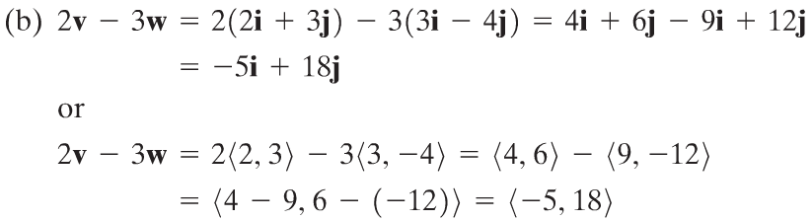
Copyright © 2012 Pearson Education, Inc. Publishing as Prentice Hall.

Slide 28

Copyright © 2012 Pearson Education, Inc. Publishing as Prentice Hall.

Slide 29

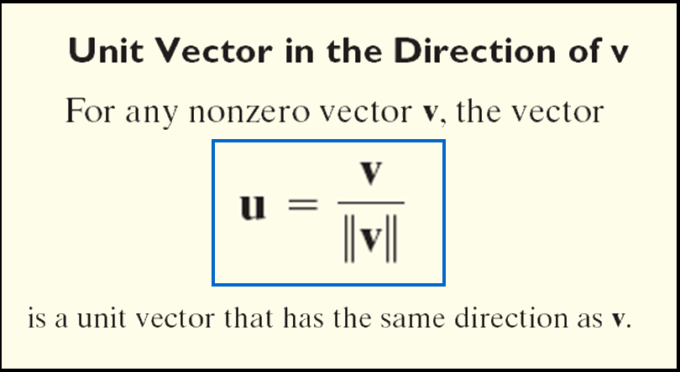

Copyright © 2012 Pearson Education, Inc. Publishing as Prentice Hall.

Slide 30
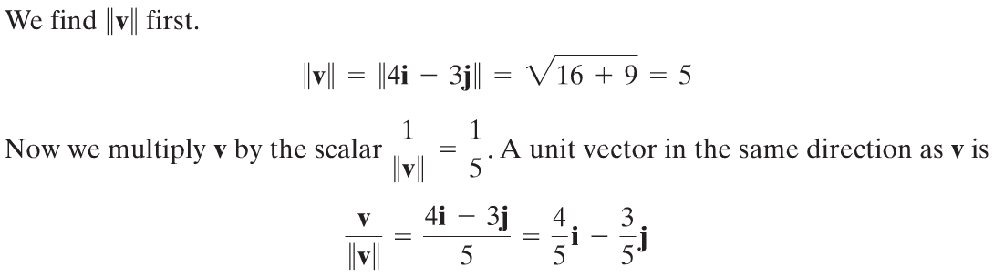
Copyright © 2012 Pearson Education, Inc. Publishing as Prentice Hall.

Slide 31
Copyright © 2012 Pearson Education, Inc. Publishing as Prentice Hall.

Slide 32

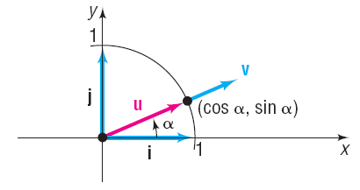

Copyright © 2012 Pearson Education, Inc. Publishing as Prentice Hall.

Slide 33
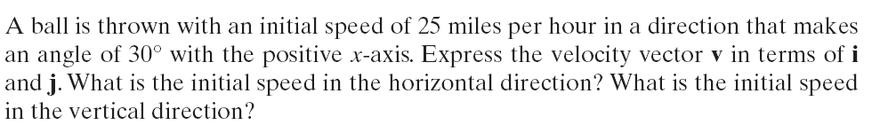
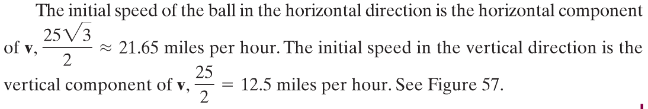
Copyright © 2012 Pearson Education, Inc. Publishing as Prentice Hall.

Slide 34
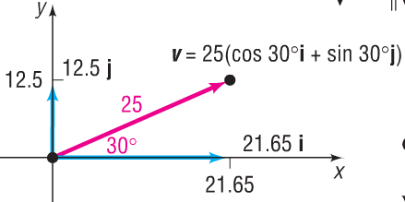
Copyright © 2012 Pearson Education, Inc. Publishing as Prentice Hall.

Slide 35
Copyright © 2012 Pearson Education, Inc. Publishing as Prentice Hall.

Slide 36
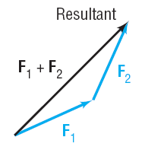
Copyright © 2012 Pearson Education, Inc. Publishing as Prentice Hall.

Slide 37
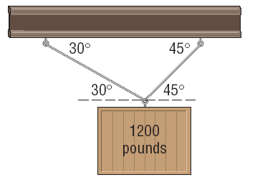
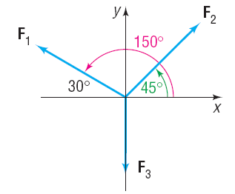
Copyright © 2012 Pearson Education, Inc. Publishing as Prentice Hall.

Slide 38
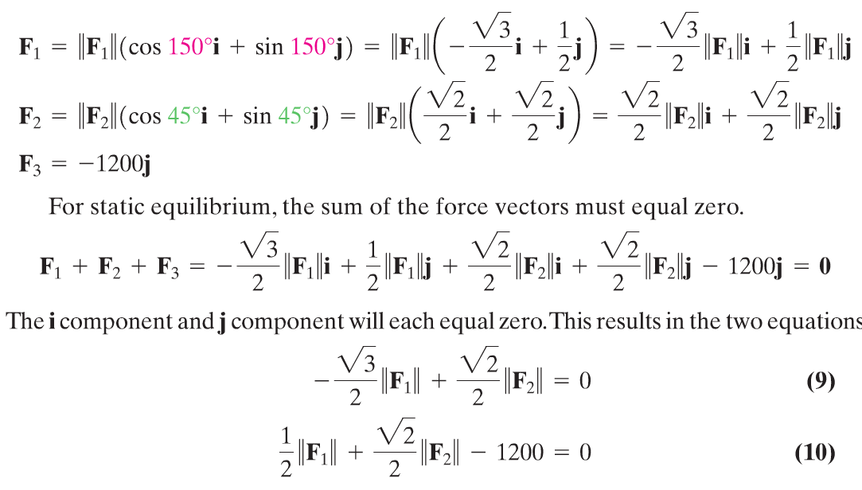
Copyright © 2012 Pearson Education, Inc. Publishing as Prentice Hall.

Slide 39

Copyright © 2012 Pearson Education, Inc. Publishing as Prentice Hall.

Slide 40

Copyright © 2012 Pearson Education, Inc. Publishing as Prentice Hall.

